Slide 1

sMED EXAMPLE pit stop TIME
FOCUSED IMPROVEMENT
MILOS CONSEIL

Slide 2

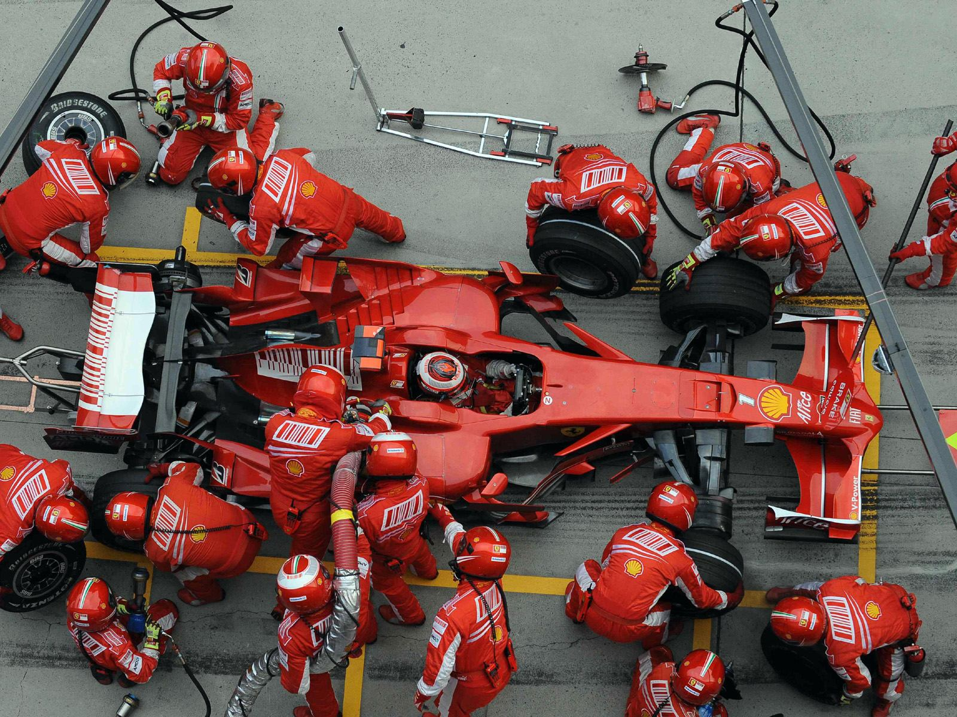
SMED EXAMPLE
(33) F1 Pit Stop (1990-2023) | WATCH HOW THE TIME DECREASES AND INCREASES | - YouTube
MILOS CONSEIL

Slide 3

Thank YOU
MILOS CONSEIL

